Slide 1



E-mail Fraud Detection
PRESENTED BY
Anmol Jain
Puneet Kumar Pal
Abhyoday
Sourabh Bhardwaj
Mentor : Mr Mohammed Ameer

Slide 2

Problem Statement
Unwanted email irritating internet connection.
Critical e-mail message are missed or delay.
Identity theft.
Resulted to untold financial loss to many users who have fallen victim of internet scams

Slide 3
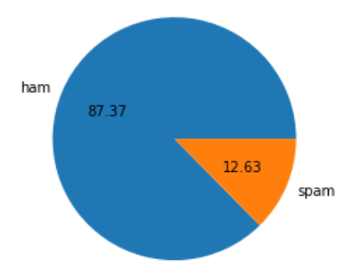
Project Overview
To give knowledge to the user about the false e-mails and relevant e-mails.
It’s also work to identify Mobile SMS.
To classify that mail spam or not.

Slide 4

Who is experiencing the Problem and how they are impacted
Play an important role in our lives because of many reasons such as personal communications, business-focused activities, marketing, advertising etc.
Make life difficult when they are used outside of their purposes.
Spam emails can be not only annoying receivers, but also dangerous for receiver's information security.

Slide 5
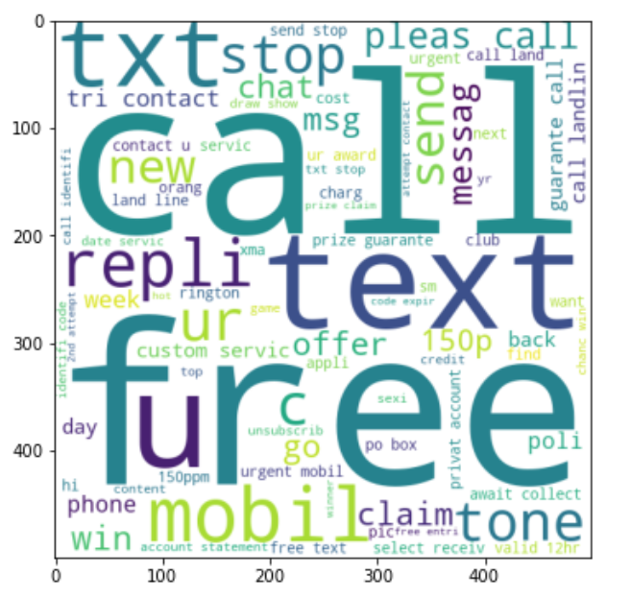
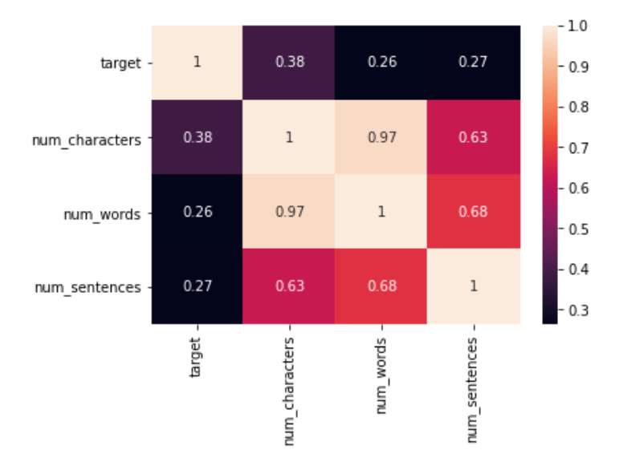
Solution
NLP concerned with the processing and understanding of human language.
Transform textual data into numerical representations Using nltk.
Predict Spam/Ham Using Naive Bayes Classifier.

Slide 6

The WOW Solution
Use NLTK library that work on human Dataset.
Naive Bayes Algorithm Gives Better Accuracy Result

Slide 7
Naive Bayes Classifier
Simple probability classifier that calculates a set of probability by counting the frequency and combination of values in given dataset.
Represent as a vector of feature values.
It is very useful to classify the e-mails properly.
The precision and recall of this method is known to be very effective.

Slide 8
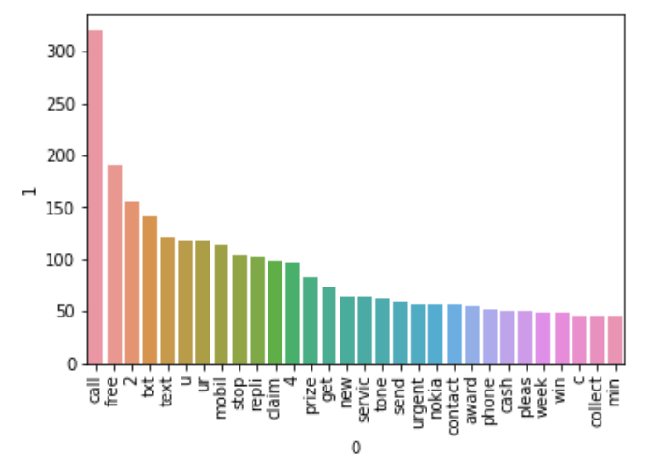
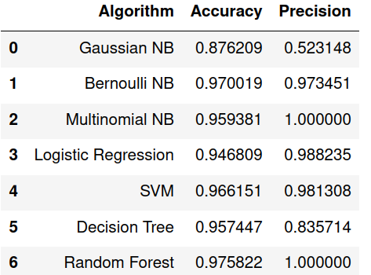
Results

Slide 9
Live Analysis

Slide 10
Credits:
Mrs khyati Nagpal
Mr Mohammed Ameer

